Slide 1
City of Oulu
A Higher Grade of Living and Business
Sanna Savolainen
Senior Advisor, International Affairs
BusinessOulu

Slide 2
OULU
SMART, HUMANE, CREATIVE
212 000 INHABITANTS
AVERAGE AGE 38
EASILY ACCESSIBLE, LIGHT OF THE NORTH

Slide 5
Education and research
Leading northern universities
High-level, international vocational college, high schools and elementary schools
World-class 6G research and education

Slide 6
Huge investments planned in Barents Region

Slide 7
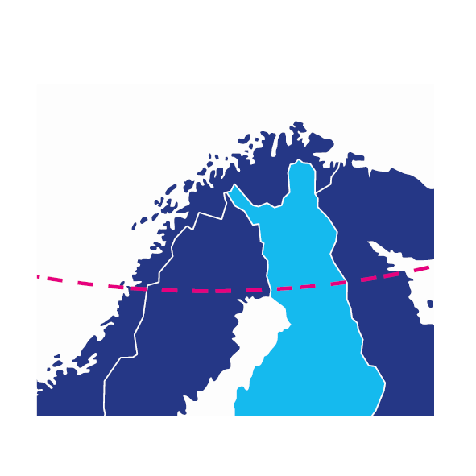
Northern investments add up to 160 billion euros
Northern Sweden
77 billion €
Northern Norway
35 billion €
Northern Finland
47 billion €
Industry
Energy
Infrastructure
Others
Tourism
75 billion €
50 billion €
27 billion €
5.4 billion €
2.6 billion €
* Source: Lapland Chamber of Commerce

Slide 8
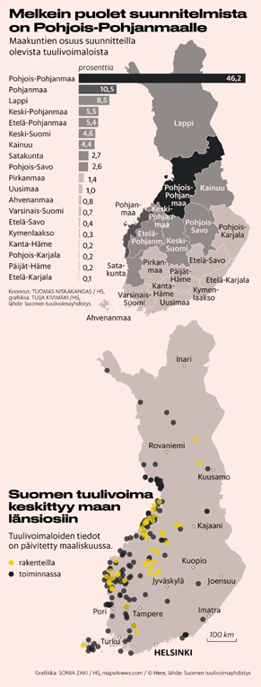
The North creates new, sustainable energy production
Climate-friendly, self-sustained
Hydropower, wind power, bioeconomy, nuclear power
Northern Ostrobothnia produces nearly 50% of Finnish wind power
The possibilities of hydrogen production
Industrial investments where green energy is available

Slide 9
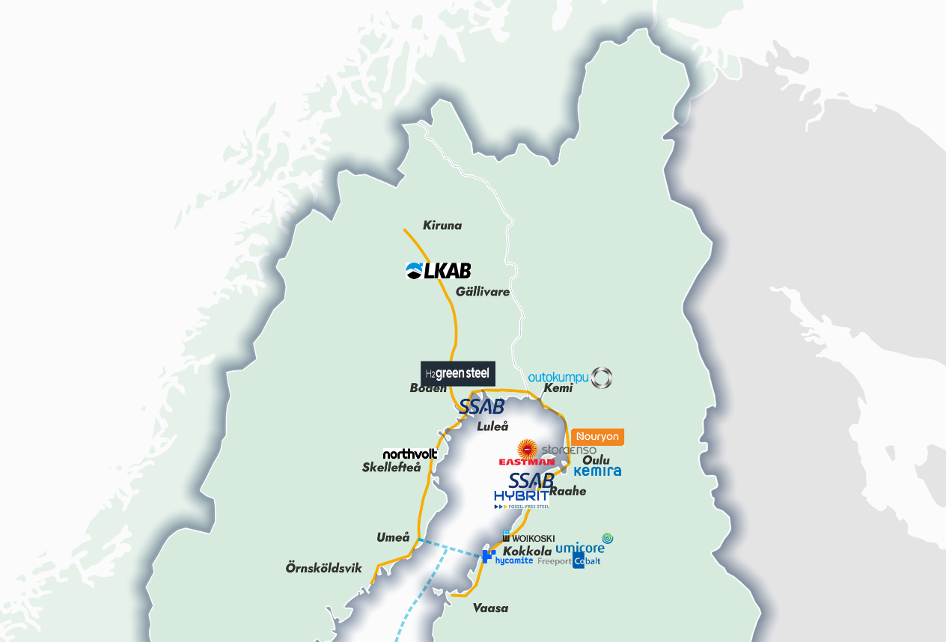
Hydrogen Valley
Possible hydrogen concentrations in the Bothnian Bay and planned Nordic Hydrogen Route
Abundace of green electricity makes it competitive.
Infrastructure projects catalyse.
Public-private commitment and collaboration enables.
Notes:
Nordic Hydrogen Route is an initiative between Gasgrid Finland and Nordion Energi to accelerate the creation of a hydrogen economy by building up a cross-border hydrogen infrastructure in Bothnian Bay region and an open hydrogen market by 2030. 1000 km of new hydrogen pipeline, 65 TWH of hydrogen demand
The aim of Nordic Hydrogen Route is to drive decarbonization, support regional green industrialization, economic development, and European energy independence. The companies seek to develop a network of pipelines that would effectively transport and store energy from producers to consumers to ensure they have access to an open, reliable, and safe hydrogen market.
Wind Power in Finland 3 257 MW (-21) → 5 000 MW in 2022
Almost 1 000 MW more annually to Oulu Region (1 Bn EUR/a)
Planned projects onshore 44 466 MW and offshore 9 905 MW
Emerging Solar Power “Eldorado”
Existing H2 production and large users of H2 Reliable electricity transmission through national grid
Extensive district heating network for utilization of waste heat Ready-made site locations with chemical industry zoning
Strong hydrogen research expertise

Slide 11
BusinessOulu International services and activities

Slide 12
BusinessOulu - partner for companies and enabler of the growth
Helps local companies to do actions for internationalization and export.
Creates an operational environment for companies and entrepreneurs that helps forward the establishment, activity, growth, competitiveness and employment of businesses.
Offers services to support the success of businesses with domestic and international partners.
Responsible for the implementation of Oulu city’s economic policy.

Slide 13
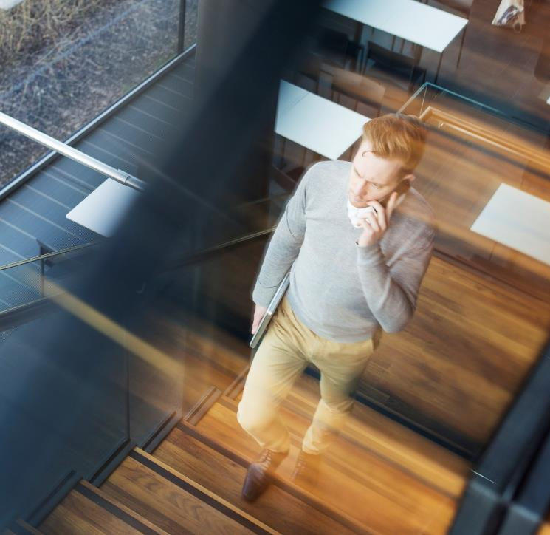
BUSINESS MODEL GENERATION
STARTING A BUSINESS
COMPANY FINANCING (PUBLIC & PRIVATE)
EXPORT AND SALES
Petri Karinen
Head of International Services
SETTING UP IN OULU
INNOVATION AND NETWORKING SERVICES
COMPANY OWNERSHIP CHANGES
TAILORED BUSINESS COACHING
EMPLOYER SERVICES
COMMUNICATION AND MEDIA SERVICES
CONGRESS EXPERT SERVICES

Slide 14
OULU – international network
Luleå
Alta
Boden
Kiiruna
Tromsø
Oslo
Jällivaara
Göteborg
Stockholm
Mo i Rana
North-America
Stuttgart
Tuttlingen
Munchen
Hannover
Tallinn
Barcelona
Madrid
Astana
Almaty
We arrange export promotion trips for companies and seek new trading opportunities.
We assist in arranging and preparing sales negotiations.
We meet potential partners and financiers.
We build Oulu's reputation as an internationally attractive area of competition for companies, investments, tourists, events and professionals.
Hangzhou
Sendai, Fujisawa
Kanagawa
Notes:
Oulu on verkostoitunut kansainvälisesti
Ruotsi ja Norja: teema arktinen eurooppa
Kazakstan: Teema Maailmannäyttely EXPO 2017
Japani: Teema puurakentaminen, peliteollisuus, health,
Saksa: Teema Health ja teollisuus sekä IoT
Venäjä: Startup –mahdollisuudet ja invest in
USA: Startup –mahdollisuudet ja invest in

Slide 15
Why business ecosystem development?
1) Regional need for cooperation in North and SMEs networking
Lessons learnt: ONE VIEW, ONE LANGUAGE HELPS COMMUNICATION AND WORKING
Arctic Trade Cooperation applied from Interreg Aurora, Partners: Finland-Norway/ BO, Viexpo, OAMK, Orinor AS, Kunnskapsparken Helgeland
2) SMEs´s challenges in transport and logistics and starting new businesses
Lessons learnt: SHARED ACTIONS AND PUBLIC FINANCING GIVE NEW OPPORTUNITIES
Business Opportunities for International Markets applied from ERDF
3) Need jobs and bigger clusters and actors to the international market
Lessons learnt: TOGETHER WE ARE STRONGER TO ANSWER TO GLOBAL ASKS
Regional ecosystems for sustainable mobility and smart manufacturing. Proposal building on interregional innovation investment instrument (13), Call strand 2b applied in March 2023. (Portugal, France, Romania, Spain, Finland and Italy)

Slide 16
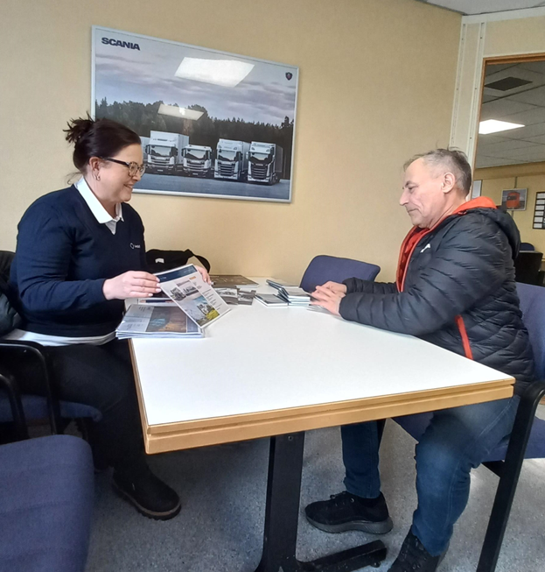
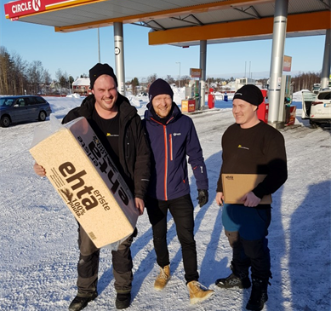
How and why do companies come to BusinessOulu to get help with their internationalization efforts? :
Stand on global trade fairs under the Oulu-umbrella
3-7 companies usually together
Consultancy services through BusinessOulu staff and partners in other markets:
BusinessOulu has staff from different countries assisting companies in internationalization, eg. Norway, Sweden, Japan, Germany.
BusinessOulu has a wide network of partners and collaborating organizations from several markets available for companies
Either direct help with finding and contacting potential partners/customers or a link to partners who might be able to help within the specified market.
Inviting delegations from around the world to Oulu:
Showing off local companies
Creating networking events
Setting up B2B meetings
Attracting foreign investments

Slide 17
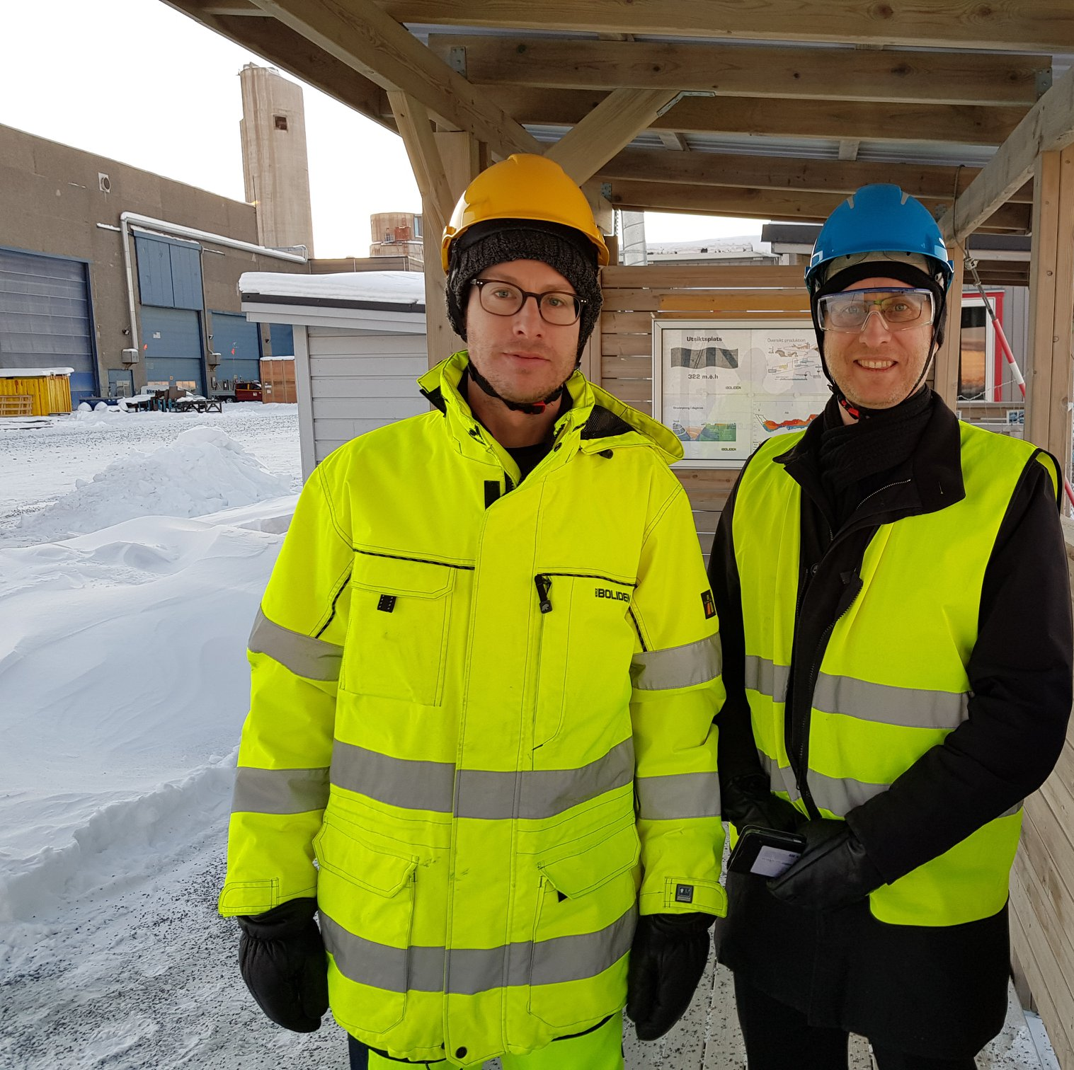
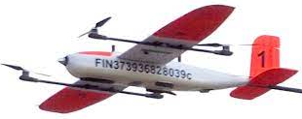
Radai Oy, geological mapping
First export sales from EU project B2B trip. After the first export sales from Sweden Radai has invested in export activities and is strengthening their growth internationally.
Lessons learnt: Participating in the export project activities “forced” Radai to try a new market, helped to get the right contacts, and meetings and taught that marketing and active sales efforts are essential.

Slide 18
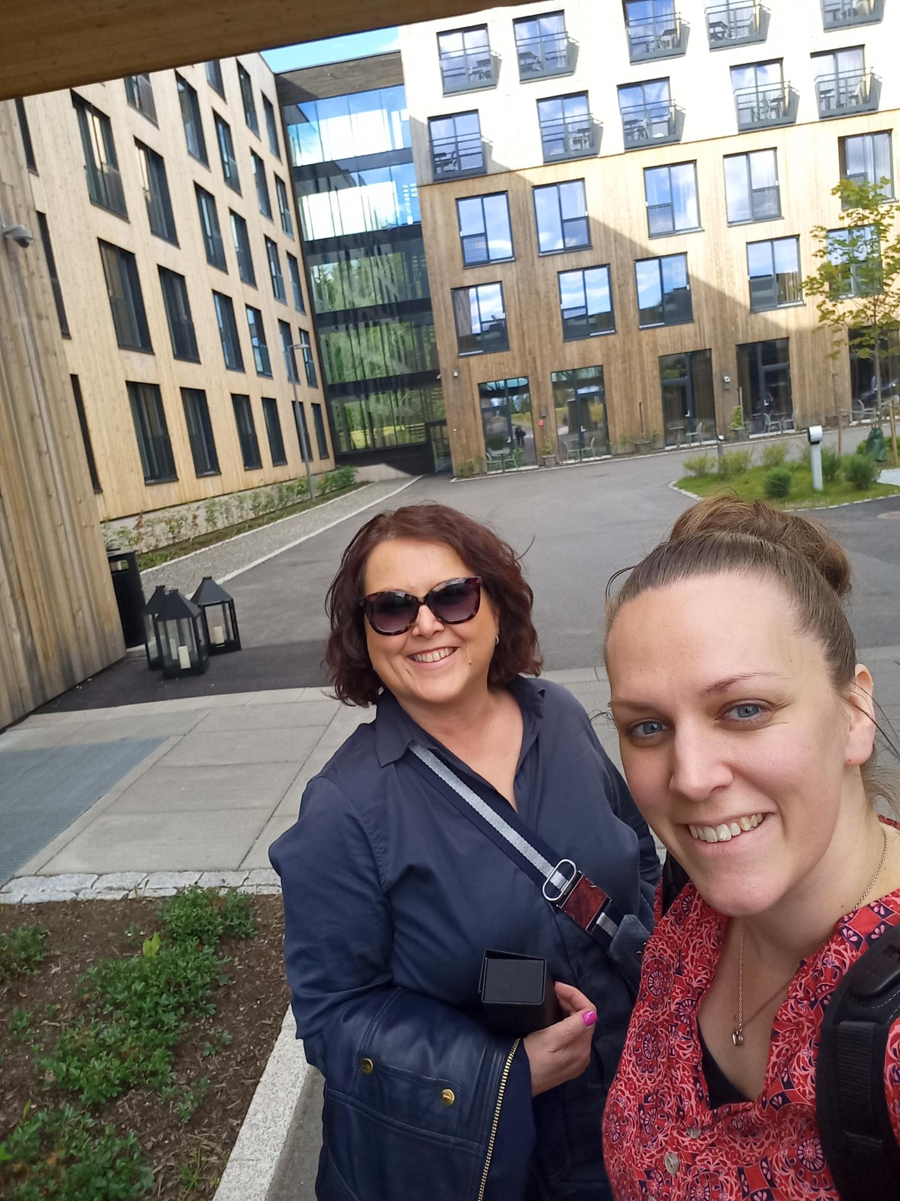
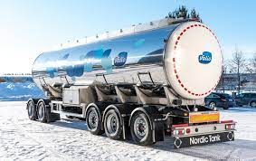
Nordic Tank Oy, manufacturer of tank trailers and services for transport solutions:
Fairs and B2B trips for stronger export. For busy entrepreneurs, 24h per day is not sufficient to concentrate on export sales
Lessons learnt: Language skills and personal network are important, partners and project activities really make a difference.

Slide 19
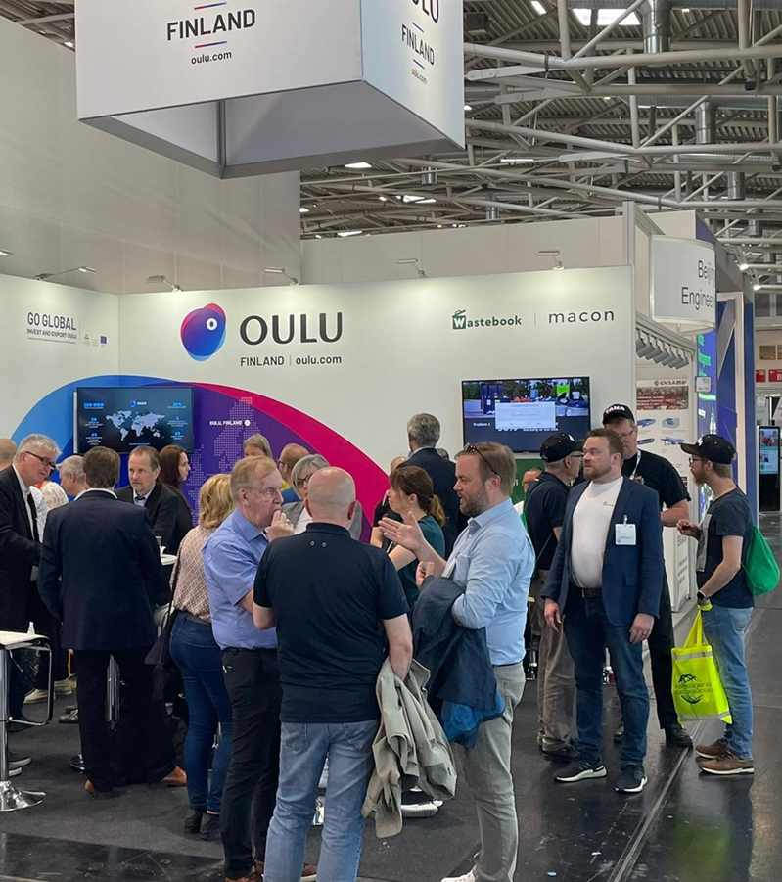
External evaluation 2017-2022 results of development work
Over 500 companies getting support
131 new jobs
24,455 M € sales

Slide 20
Thank you!
Sanna Savolainen
Sanna.l.savolainen@businesssoulu.com
+358 44 703 9760

